Slide 1
Configuration Manager 2007 R3
Wally Mead
Senior Program Manager
Microsoft Corporation

Slide 2
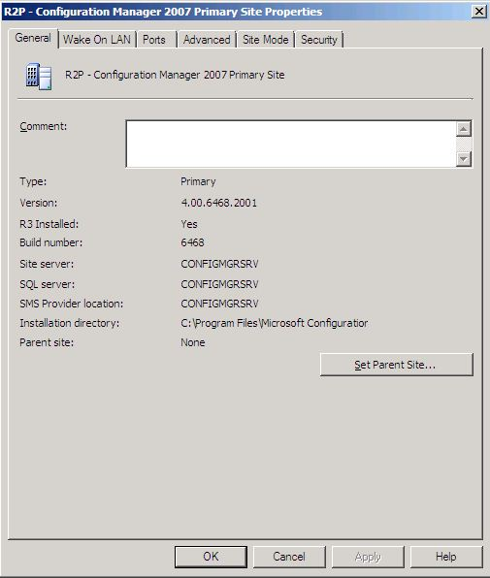
Feature Overview
Power Management
Monitoring and planning
Setting of power policy
Summary reporting
Scale and performance
Delta AD discovery
Real-time collection updates
Scale to 300,000 clients per hierarchy
Operating System Deployment
Prestaged (OEM) media
Simplified resource management
MDM licensing additions

Slide 3
Support Configurations
Configuration Manager Release | Configuration Manager 2007 R3 Evaluation Release | Configuration Manager 2007 R3 Feature Update Release
SMS 2003 SP1 | No | No
SMS 2003 SP2 | No | No
SMS 2003 SP3 | No | No
Configuration Manager 2007 (with no service pack applied) | No | No
Configuration Manager 2007 Evaluation Release | No | No
Configuration Manager 2007 SP1 | No | No
Configuration Manager 2007 SP1 Evaluation Release | No | No
Configuration Manager 2007 SP2 | No | Yes
Configuration Manager 2007 SP2 Evaluation Release | Yes | Yes
Configuration Manager 2007 SP2 with R2 | No | Yes
Configuration Manager 2007 SP2 with R2 Evaluation Release | Yes | Yes
R3 includes R2, installing R3 will install the R2 feature set if R2 is not already installed
Only ConfigMgr07 SP2 clients are supported with ConfigMgr07 R3
All International Server SKU’s will be developed

Slide 4
Power Management

Slide 5
Agenda
What is environmental IT?
Microsoft’s mission and technical philosophy
Barriers for entry
R3 vision and scope
Personas
Key concepts
R3 investments

Slide 6
What is Environmental IT?
We have diminishing natural resources
Decreasing the carbon footprint of human beings
Turn off unused equipment
The lights are on but nobody is home
Help organizations save money
Must not impact end user productivity

Slide 7
Microsoft’s Mission
Leverage technology for positive environmental impact
Power efficient HW (OEM partners)
Power efficient Windows as platform
SC suite to monitor user activity/consumption/cost and apply corporate policies
Technical Philosophy
Windows as the foundation of green computing
User centric, understand and honor user activity
Don’t have to deal with holidays, days off…etc
Sleep state is key
Power saving between power off and sleep states is virtually zero
Ability to wake up from sleep when required
Wake up to receive critical updates and apps
Client wakes up from sleep in nonworking hours
Checks the ConfigMgr policy and executes it
If no policy client returns to sleep
Built to save money for our customers

Slide 8
Barriers to Entry
My hardware doesn’t support it: Why systems do not support or failed to apply power policy defined by admin
Inventory: we will gather up power state capabilities can exclude systems that don’t meet certain checks
Report up errors caused by power plan implementation
Worst offenders: video drivers and external USB drives
After hours operation: Most operations occur after hours so how can I get sleep benefits but not miss my windows?
Wake up specified per collection and will wake up clients that support it (desktops primarily)
User override: Allow user to change override system policy
Use Windows UI for user override long term, natural UI
Data Warehouse: Power management companies mandate power management in effect for 2 years for rebates. Some rebates require 3 years of use

Slide 9
ConfigMgr 2007 R3 Vision and Scope
Vision: Enable Configuration Manager to further reduce the operational costs of IT by providing basic power management features native to the product
Scope
Focus on client scenarios but will work on server
Understand user activity
Understand machines not capable of power management
Use safest sate possible while applying power policies (Stand by/Sleep)
Ability to wake up from sleep to receive critical software update or app policy
Dashboards of current power state tailored for facilities and purchasing personas
Define new or customize out of the box power management policies
Apply power policy, monitor and report consummation by individual system, facility, building..etc
Calculate savings in WATT, $ and CO2 emission saved
Simple and easy opt out process for admins
Out of Scope
Provide in-use file recovery
Non-windows power management
Windows Mobile Device power management
Detailed system model power consumption metrics
End user opt out
Application exceptions

Slide 10
ConfigMgr 2007 R3 Investment
Phase 1: Monitor current power state and consumptions
Phase 2: Plan and create power management policy, check for exceptions
Phase 3: Apply power management policy
Phase 4: Check compliance and report savings in power consumption and cost

Slide 11



Phase 1: Monitor current state and consumption
How can I decrease utility costs?
Ray asks Meg to provide analysis of power consumption of desktops, laptops, monitors in Woodgrove
Meg enables CM power management agent to understand current power state and consumption
CM collects and reports “current” power management state and consumption
Only 20% of computers and monitors are turned off/stand by when inactive
10% of machines not capable of having power management enabled
91% of people zero activity after 5 P.M.
Total energy consumption
Before implementing power policy
568,797 kWh
$771,192

Slide 12
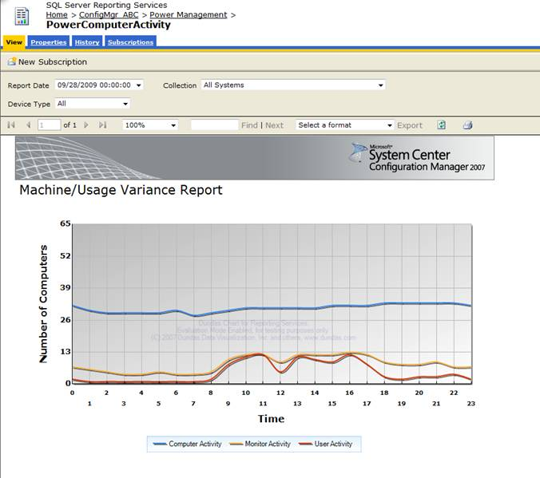
User/Machine/Monitor Activity Report

Slide 13
Phase 2: Plan and create power management policy
Analyze the data collected to define right power policy
Examples:
User activity is heavy 8 – 11 A.M. , decrease 11 A.M. – 1 P.M., and picks up again 1 – 4:30 P.M.
91% of people zero activity by 5 P.M.
91% of people zero activity by 4 P.M. on Friday
98% of people zero activity during weekends

Slide 14
Phase 2: Plan and create power management policy cont.
Look for clients that can’t support power management
Exclude clients that shouldn’t be managed for power
Define policy for each facility (organization, department)
Define different policy for peak and non-peak times
Out of the box power policies
Balanced, Power saver, High performance (XP, Vista & greater)
Customize out of the box power policies

Slide 15
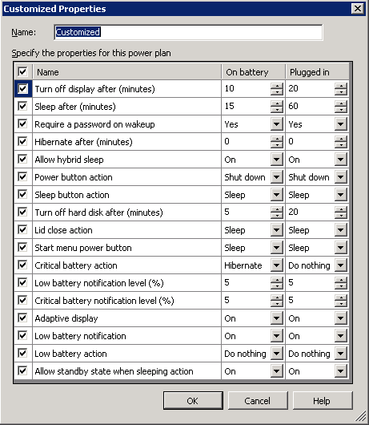
Power Policy Properties
Power plan name | Vista, Win 7 and Server 2008 | XP and Server 2003
Power saver | Apply Power Saver power plan | Apply Minimal power management power scheme
Balanced | Apply Balance power plan | Apply Home/Office Desk power scheme
High performance | Apply High performance power plan | Apply Always On power scheme

Slide 16
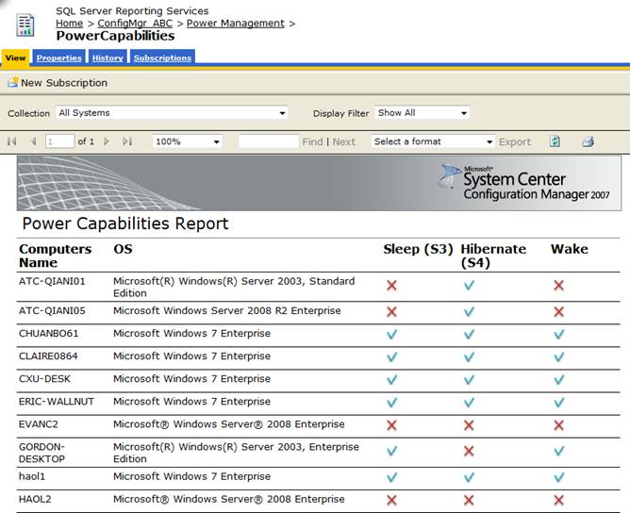
Power Capabilities Report

Slide 17
Phase 3: Calculate savings
I need to prove energy saved and pollution prevented
Ray asks Meg to decrease the energy cost by implementing efficient power management policies
He request proof of saving to use in tax savings
Meg defines and applies power management policies using CM, continues to monitor power state and consumption
CM reports savings
Meg send link of report to Ray
CM applies power policy and reports power management state and consumption
Now 90% of computers/monitors are turned off/stand by when inactive
Energy Saved (kWh) | $ Saved Annually | Pollution prevented: CO2 (in tons) | Acres of trees planted | Number of cars removed
5,928,625.00 | $533,576 | 13650 | 2814 | 2268
Total energy consumption
After power policy
2,640,172 kWh vs 8,568,797 kWh
$237,615 vs $771,192

Slide 18
Phase 4: Check Compliance and Report savings
Inventory report for power settings
Peak and non-peak time for user activity
On collection bases, select a time period and report:
Power consumption (kwh)
Power cost ($)
CO2 footprint
Retain power monitoring data for 13 months

Slide 19
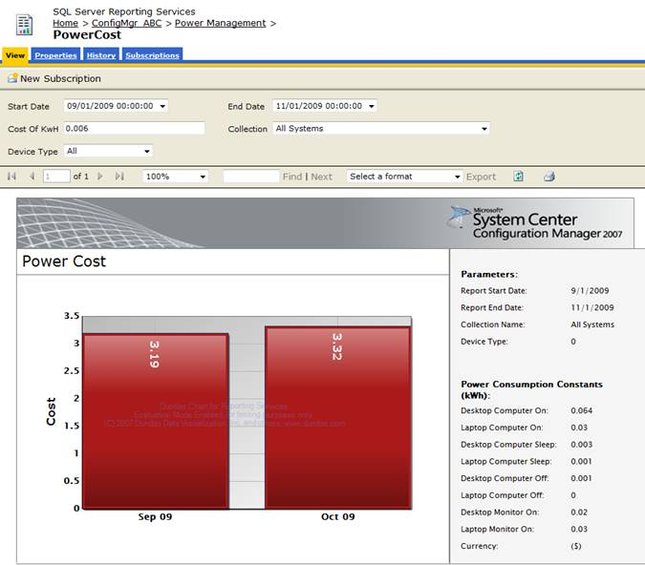
Power Cost Report

Slide 20
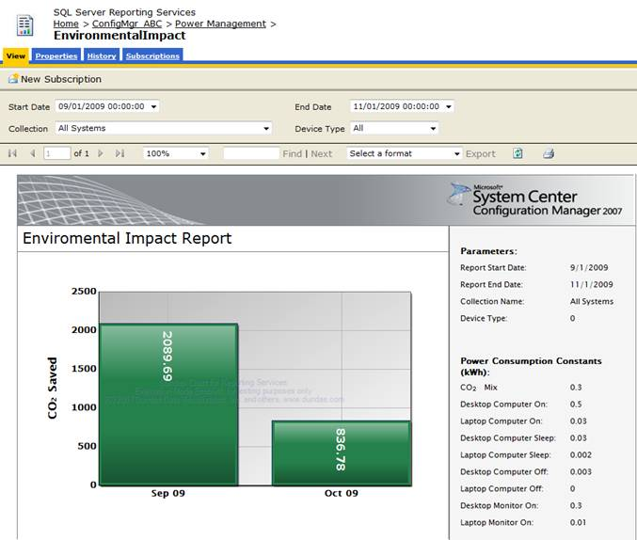
CO2 Footprint Report

Slide 21
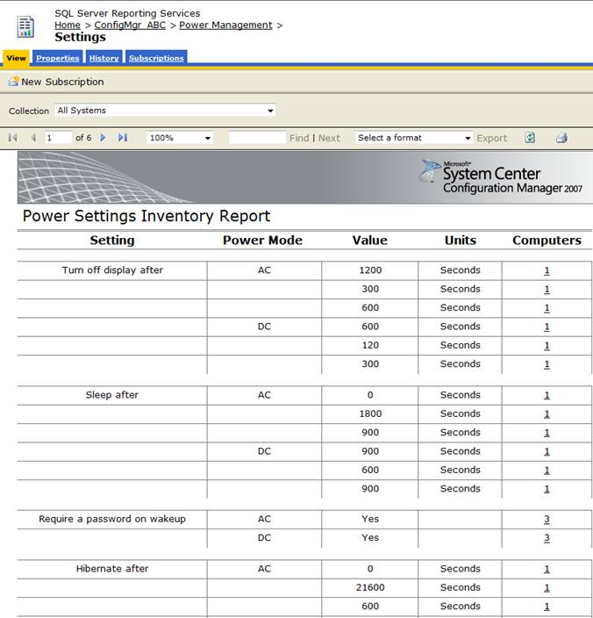
Power Settings Inventory Report

Slide 22
Scale and Performance

Slide 23
Distribution Challenges Today
An end user changes AD OUs and doesn’t receive any new software for at least a day
A new employee joins the company and it takes at least one day for that employee to receive any new software
An admin needs to continually maintain their OSD task sequences so the appropriate software and software updates are applied during the imaging process

Slide 24
Delta Active Directory Discovery
Each AD discovery query has 2 tasks:
1. Discover any changes to any users or systems, based on the query, that would likely affect targeting (default is 5 minutes)
2. Perform a periodic “full scan” to capture users and systems last logged time, ensuring active users and systems are not made obsolete
On an individual query basis, select “Run “discovery now” for a full scan

Slide 25
Delta AD Discovery Cont.
AD queries supported are:
User
User Group
System
System Group
NOTE: TBD for Security Group support with R3
Able to view the last start time and last end time for each query as well as the average duration, calculated on the last 10 executions

Slide 26
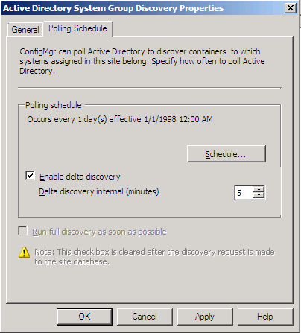
Delta AD Discovery Cont.
Note: Delta Discovery is not enabled by default

Slide 27
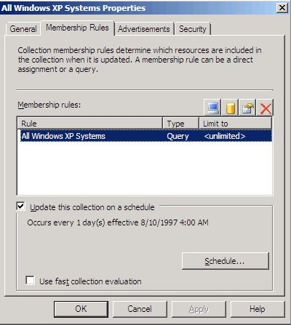
Fast Collections
Step 1: Collection is marked for fast evaluation

Slide 28
Fast Collections Cont.
Step 2: Resource that Fast Collections applies to are:
Systems initially discovered
Clients provisioned via OSD
Initial hardware inventory reports from clients
Clients upgraded to a new ConfigMgr client version
Note: Fast Collections do not apply to known clients within ConfigMgr, only the above four states
Step 3: Resource ID inserted into change tracking table where a separate collection evaluator thread is run (every 5 minutes) and evaluates collections marked for fast evaluation
NOTE: Full evaluations are still processed in the same way. A new collection needs a full evaluation to show existing clients

Slide 29
Software Distribution process for new machines
Latency – ConfigMgr07 | Latency – ConfigMgr07 R3
Depends on AD | Depends on AD
Min = 24 hours | Min = 5 mins
Default = 24 hours, Min ~ 1 hour | Default = 24 hours, If fast collection, then min is 5 minutes
~5-30 mins depending on queue | ~5-30 mins depending on queue
Once an hour | Once an hour or when user logs on (CM07Sp2 contained change to evaluate policy at logon, doesn’t take 3-5 minutes anymore)
Within 1-2 min of receiving policy | Within 1-2 min of receiving policy
Depends on content | Depends on content
User/Device created in AD or AD Replication
User/Device discovered in AD – Inserted into ConfigMgr DB
User/Device added to Collection
Client evaluates policy
Device requests policy for User/Device
Policy created for User/Device
Client downloads and installs content
CM agent install

Slide 30
Supported Site Hierarchy Scale
A central site now supports 300,000 clients when using the default settings for all Configuration Manager 2007 features
NOTE: No change to other site and site role supported numbers

Slide 31
Prestaged Media

Slide 32
Overview – Prestaged Media
Customers requirements:
A way to integrate with OEM factory imaging
Leverage imaging at the OEM to speed up their new hardware deployments
Keep inline with their current processes
Prevent new administrative overhead
Our Solution
Provides a way to use existing packages in ConfigMgr
Integrates with existing task sequences
Easy and repeatable process to create media

Slide 33
Prestaged Media Process
Use Task Sequence Media Wizard to create OEM Media
Input parameters for boot media
Password
Certificate
Unknown machine support
PXE Support – do not use for OEM Media
Select Boot WIM and OS WIM
Generated WIM file – send to OEM
OEM uses imagex to put images on your systems
Upon return – system boots to boot media and begins Task Sequence

Slide 34
Prestaged Media – How it works
Integrated into the Task Sequence Media Wizard
Hybrid .wim file containing boot media and operating system .wim file
New MediaType (“Prestaged”) added for condition statements to leverage one task sequence
Apply OS action updated to interact with new MediaType, will not wipe drive when set.

Slide 35
Simplified Resource Management

Slide 36
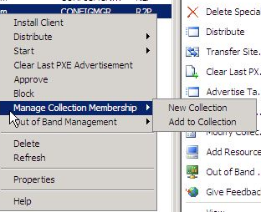
Resource Management Improvements
Add to Collection - Adds the currently selected resource(s) to an existing collection (as specified by the Administrator)
New Collection - Adds the currently selected resource(s) to a new collection (as specified by the Administrator)

Slide 37
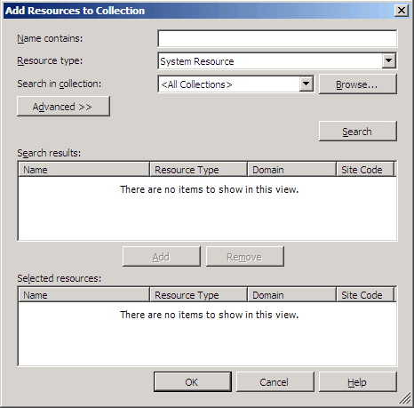
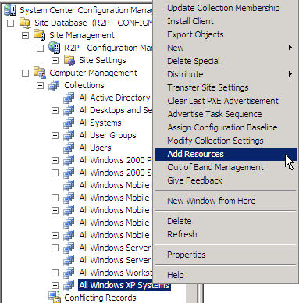
Resource Mgmt Improvements Cont.
Remove from Collection - Removes the currently selected resource(s) from the current collection
Add Resources - Launches a dialog that allows administrators to search for resources and add create direct membership rules.

Slide 38
MDM License Change

Slide 39
MDM License
License details should be available by the end of September. Tentatively...
MDM as a stand-alone product on the price list will not be available
MDM will be purchased as Configuration Manager, under Configuration Manager VL

Slide 40

© 2008 Microsoft Corporation. All rights reserved. Microsoft, Windows, Windows Vista and other product names are or may be registered trademarks and/or trademarks in the U.S. and/or other countries.
The information herein is for informational purposes only and represents the current view of Microsoft Corporation as of the date of this presentation. Because Microsoft must respond to changing market conditions, it should not be interpreted to be a commitment on the part of Microsoft, and Microsoft cannot guarantee the accuracy of any information provided after the date of this presentation. MICROSOFT MAKES NO WARRANTIES, EXPRESS, IMPLIED OR STATUTORY, AS TO THE INFORMATION IN THIS PRESENTATION.

